Slide 1
Applied Data Science
Portfolio Milestone
Kanning Wu
SUID: 714914874
kwu130@syr.edu

Slide 2
Introduction
The applied data science program at Syracuse University’s School of Information Studies provides students the opportunities to collect, analyze, decide and implement all data related tools and techniques. Each project listed below, data were collected from online sources and stored in SQL or .csv file. By using Python or R packages, visualization and analysis were generated and implemented. From the calculated results, insights from datasets can be developed. All these skills I learned at the School of Information Studies helped future data scientist focusing on the field of accounting, finance, marketing analytics

Slide 3
Projects List
Courses Project Overview Skills
IST 659 Database designing related to SQL Server, Access
COVID-19 Power BI,
SQL Server Data Tools
IST 687 Global Fossil Fuel Consumption R, Machine Learning
IST 707 Predicting Airbnb Prices in NYC R, Prediction Modeling,
Data Analysis
IST 736 Data Analysis of the City of San Python, Visualization,
Diego Data Analysis, Natural
Language Processing

Slide 4
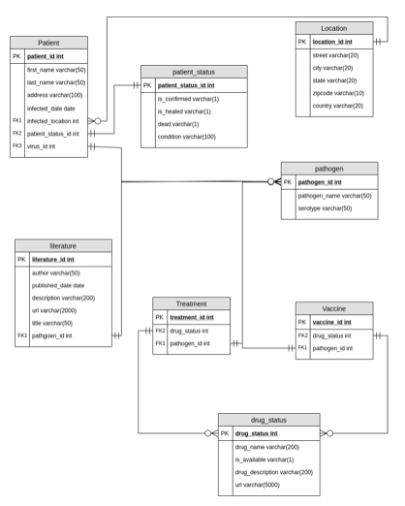
IST 659

Slide 5
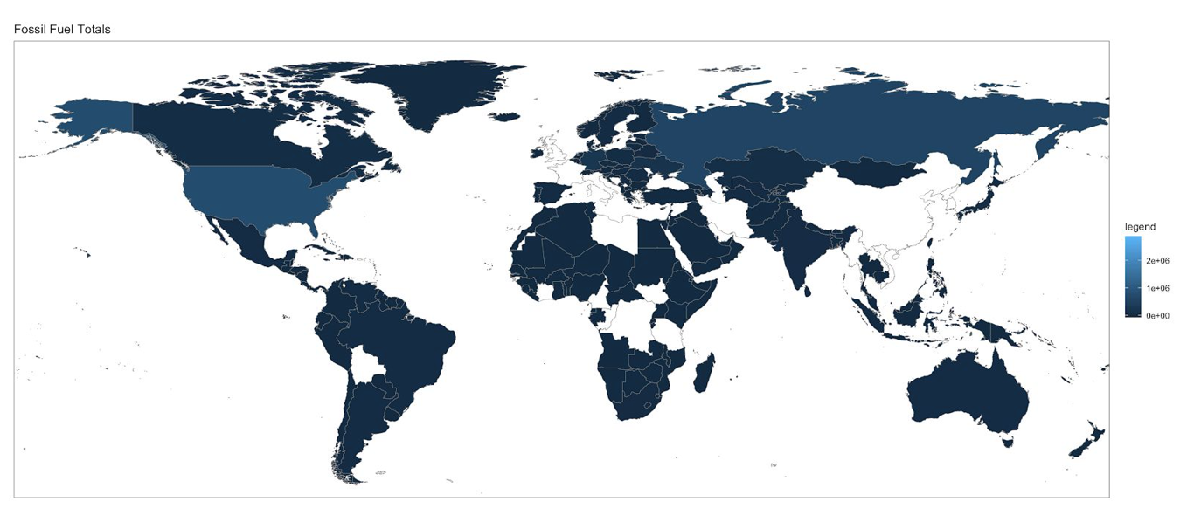
IST 687
The US fuel consumption is different from other countries, especially comparing with other American countries and Europe. This indicates that there are significant differences in fuel consumption policies.

Slide 6
IST 707
Model Summary and Comparisons (Green = Highest, Red = Lowest) The classification models we created using the data are fairly accurate at predicting if the price of an Airbnb listing is going to be above or below the average of $152.70. Each one does it roughly 80% of the time, with the J48 decision tree model being the most accurate and the Rpart decision tree model being the least.
Model | Overall Accuracy | Precision <Avg | Recall <Avg | Precision >Avg | Recall >Avg
R-Part | 78.57% | 86.9% | 83.1% | 59.7% | 66.5%
J48 | 81.29% | 86.7% | 86.3% | 69% | 69.8%
Naïve Bayes | 79.48% | 83.4% | 88% | 68.6% | 59.9%
KNN | 79.48% | 83.4% | 88% | 68.6% | 59.9%
Random Forest | 80.96% | 86.7% | 85.8% | 68.2% | 69.9%

Slide 7
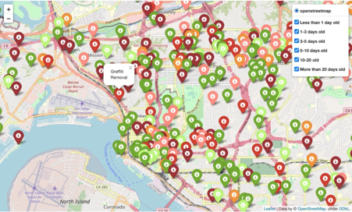
IST 736
From the data, the city service has many
different issues. Some have been dealt
with rapidly in a few days; however, there
are still many issues are not addressed
more than 30 days.

Slide 8
Thank You

